Slide 1
Smithgall Woods Park Website
Project Updates
MIST7590 – MIT Project I
Andrea Castresana
Jennifer Lazo
Alexander Couch
Clark Williams
Eliseo Santos
October 25, 2017

Slide 2
Overview
SGW Background
Team Member Roles
System Analysis
User/System Requirements
User Stories
Use Case Diagrams
Workflow Diagrams
Data Models
Way Ahead

Slide 3
Background
Friends of Smithgall Woods Park is a state park in Helen, GA
Recreational activities include fishing, hiking, camping, and volunteering
Part of the site is used to track Friends Chapter members’ volunteer hours which are reported to the state, and SGW earns revenue
Other parts of the site provide links to external websites such as
Lodging Reservations
Newsletter Subscription
Becoming a SGW Friend and Volunteer
Signing up for Volunteer Opportunities

Slide 4
Team Member Roles
Team Leader/Project Manager – Eliseo
Client-side Developer – Jennifer, Andrea
Server-side Developer – Jennifer, Alex, Eliseo
Database Manager – Eliseo, Clark
UI/UX Design Manager – Alex, Jennifer
Test Manager – Eliseo, Clark
Business Analyst/Requirements Manager – Andrea, Clark

Slide 5
System Analysis
Investigation of SGW website
Discovered unnecessary admin accounts
Found outdated plugins
Identified malicious injected code & disabled it temporarily
Proposed temporary solution to security vulnerability
Gathered initial user rqmts & prioritized them from high to low
Developed prioritized rqmts into proposed system rqmts
Created home page mockups for Mobile & PC views
Building simple website prototype for usability testing
Initial response from Mr. Pease (client) received Sep 30th

Slide 6
Website Features | User Requirements | Priority
1.0 Website Pages (Site navigation & content presentation) | 1.1 Smithgall Woods website shall be designed with user-friendly navigation that allows users to find information quickly through logical menu structure. | Low
 | 1.2 Site shall include “About Us Friends” page with links to http://www.gastateparks.org/smithgallwoods | High
 | 1.3 Smithgall Woods website content of each page shall be arranged in a way to improve its appearance and make it interesting to existing users and future visitors to the site. Text and pictures are a particular concern to the stakeholder | High
 | 1.4 Site shall display an additional web page that provides information about their “All Access” trail | High
2.0 Website Construct | 2.1 The website shall be rebuilt using Java and Javascript platforms in a way that doesn’t prevent designated representative from maintain and update the site. The majority of representatives will have limited knowledge in these programming languages. | High
 | 2.2 Instructions and training sessions will be provided in “real world English” to representatives so they know how to address any issues and how to maintain the site. | High
3.0 Become a Friend or Volunteer Page | 3.1 The page shall have more detailed information about becoming a friend or volunteer including directions, volunteer training day information, and working hyperlinks. | Low
 | 3.2 All hyperlinks shall be active, correct, and current. | High

Slide 7
Website Features | User Requirements (Continued) | Priority
4.0 Cottage Accommodations Page | 4.1 Smithgall Woods cottage accommodations page shall link directly to the relevant state parks reservations page. | High
 | 4.2 Smithgall Woods cottage accommodations page shall be renamed to Reservations and list group (pioneer) camping and picnic shelter information, which are reserved through the same link. | Low
5.0 Volunteer Hours Log Page with Mobile Capability | 5.1 Smithgall Woods application shall validate volunteers, jobs and hours by authentication process. | High
 | 5.2 Smithgall Woods application shall be formatted with mobile devices in mind so that logging data via mobile is user-friendly. | Medium
 | 5.3 Total volunteer hours for Hardman Farm shall be tracked also through SGW website | High
6.0 Volunteer Report Generator Page with Separate Login | 6.1 Smithgall Woods application shall generate volunteer reports showing the number of volunteer hours. | Low
 | 6.2 Smithgall Woods application shall be capable of setting up user access to Report Generator for designated individuals only. | Low

Slide 8
Website Features | System Requirements | Priority
1.0 Website Pages (Site navigation & content presentation) | 1.1 Each site page shall display a menu bar with the following categories that contain relevant subcategories to allow users to find information quickly and provide better user experience: Home, About Smithgall, Activities, Events, Volunteer Opportunities, Contact Us, and Friends Corner. Currently, several subcategories are grouped under unrelated headings such as About Smithgall, Friends Chapter, etc. | High
 | 1.2 Site shall include “About Us Friends” page with links to http://www.gastateparks.org/smithgallwoods | High
 | 1.3 Each page shall use darker font with higher contrast background and consistent line spacing, font type/size, and bold-type font that provides better user experience: double-line spacing between paragraphs, after page titles, and after subheadings; at least 26pt bold font for page titles and at least 20pt bold font for subheadings. | High
 | 1.4 Site shall display an additional web page that provides information about “All Access” trail. | High
2.0 Website Construct | 2.1 The website shall be rebuilt using Java and JavaScript platforms in a way that doesn’t prevent designated representative from maintain and update the site. The majority of representatives will have limited knowledge in these programming languages. | High
 | 2.2 Instructions and training sessions will be provided in “real world English” to representatives so they know how to address any issues and how to maintain the site. | High

Slide 9
Website Features | System Requirements (Continued) | Priority
4.0 Cottage Accommodations Page | 4.1 Page shall link directly to the relevant state park lodging reservations page. All hyperlinks shall be active and current. | High
 | 4.2 Details shall be provided for each lodging location such as different attractions, landmarks, trails, etc. to help users refine their search based on what they want to see. | High
5.0 Volunteer Hours Log Page with Mobile Capability | 5.1 The app shall allow volunteers to create user account with their name, date of birth, home address, email, and phone numbers. The application shall allow a park representative to validate user accounts. | High
 | 5.2 Volunteers with user accounts shall be able to log their volunteer date, time, locations, and tasks performed. The app shall allow a representative to log in and confirm these data entered by volunteers. | High
 | 5.3 App menu shall be formatted for mobile browsers using Bootstrap for ease of viewing and item selection. Site forms shall be formatted for mobile browsers using Bootstrap to make data entry easier and reduce the amount of typing required. | Medium
 | 5.4 Total volunteer hours for Hardman Farm shall be tracked also through SGW website. Volunteer Hours table in the database will include the Hardman hours with distinct label. The Hardman Farm manager can then be given access to the site to log in all volunteer hours or the volunteers can log in their Hardman Farm hours at the same site using a selector to distinguish them from their other volunteer hours. | High

Slide 10
User Stories
As a Friends Chapter Member,
I can easily register as a volunteer
I can log my volunteer hours from my phone
It is easy for me to become a donating “Friend”
I can easily find the park and view upcoming events
As an Administrator,
It is easy for me to add photos to the website
I can input, view, edit, and approve volunteer hours
I can easily publish upcoming events
As a Site Maintainer,
I can easily understand the website and add features
As a Visitor,
I can easily find fun activities for me, my friends and family to do
I can easily find information about renting a cabin

Slide 11
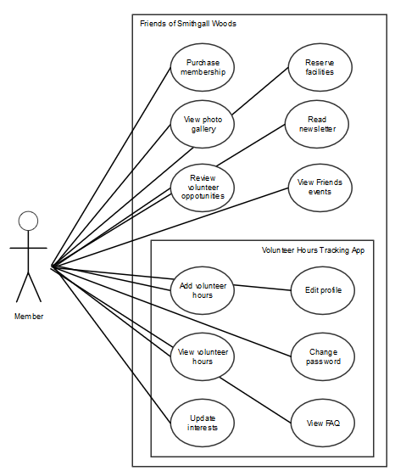
Friends Volunteer Use Cases
Notes:
The person who performs volunteer work for Smithgall Woods (SGW) is a Friends Chapter member. All other volunteers that are NOT Friends Chapter members are tracked through the Georgia State Park website.

Slide 12
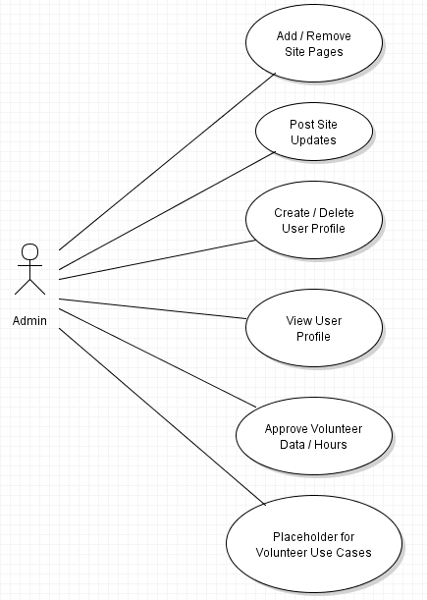
Admin Use Cases
Notes:
The last bubble “Placeholder for Volunteer Use Cases” is only used in this diagram to indicate some use cases from the Volunteer actor.

Slide 13
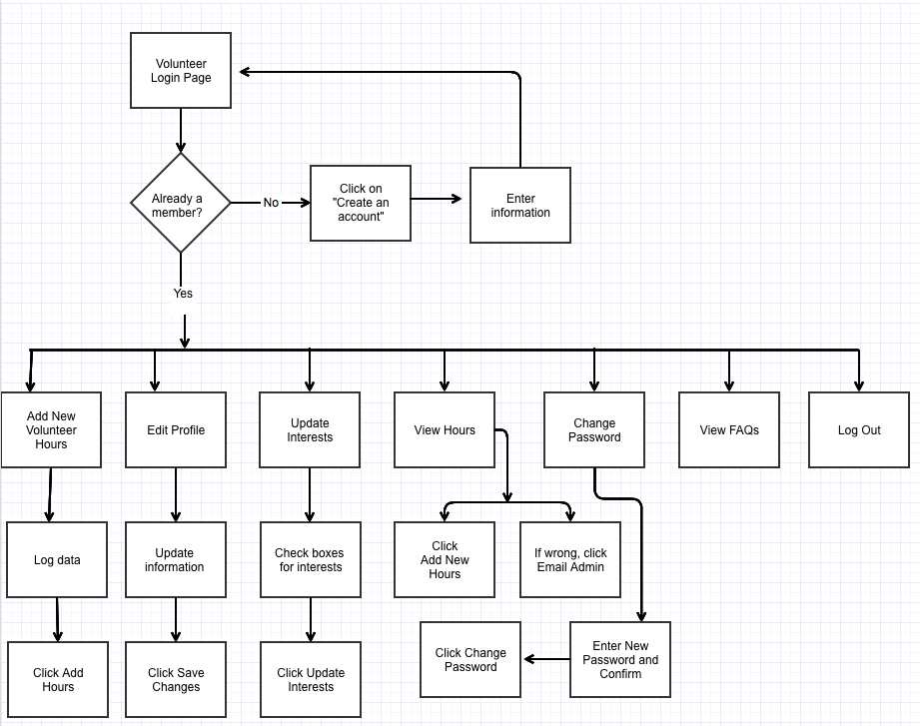
Friends Volunteer Workflow
Notes:
This Friends Volunteer workflow describes the existing Friends Volunteer Log process.

Slide 14
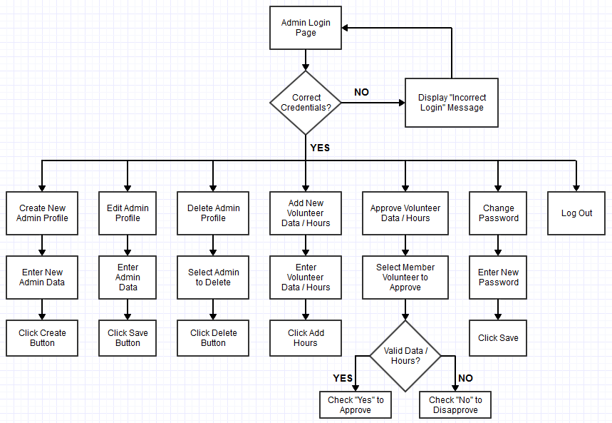
Admin Workflow
Notes:
This Admin Workflow is based on the proposed user/system requirements. A separate login page for Admin will be developed, and an Admin/Password pair will be set up initially in the MySQL “admin_login” table. Then, the Admin must log in first to create user accounts with admin privileges.

Slide 15
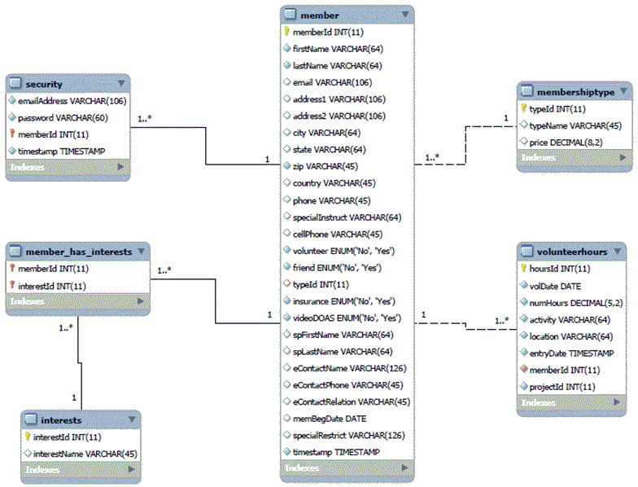
Existing Data Model
Notes:
Based on the team’s initial assessment of the SGW’s existing databases, only six tables were originally defined as shown here with one-to-many relationship. The rest of the tables in the databases were defined without references or relationships.

Slide 16
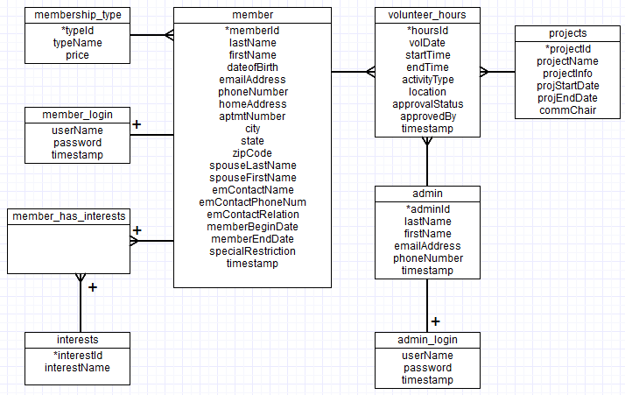
Suggested Data Model
Notes:
This data model is based on the proposed user/system requirements. The “admin” and “projects” tables are added and related to the “volunteer_hours” table with one-to-many relationship as shown here. In the “volunteer_hours” table, two attributes (approvalStatus and approvedBy) are also added for Admin validation of volunteer data.

Slide 17
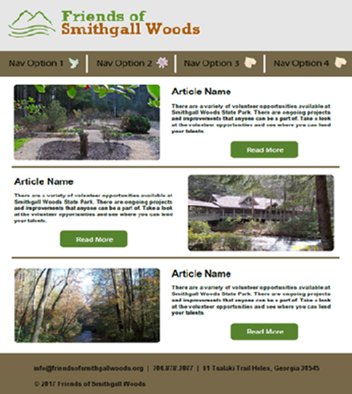
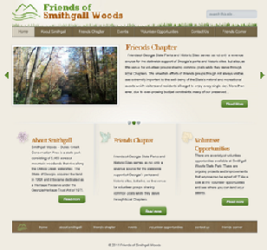
Home Page Mockup (Desktop Version)
Proposed Home Page
Current Home Page

Slide 18
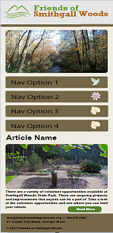
Home Page Mockup (Mobile Version)

Slide 19
Way Ahead
Awaiting clarification from Mr. Pease on following requirements
5.2 Volunteers with user accounts shall be able to log their volunteer date, time, locations, and tasks performed. The app shall allow a representative to log in and confirm these data entered by volunteers
5.4 Total volunteer hours for Hardman Farm shall be tracked also through SGW website. Volunteer Hours table in the database will include the Hardman hours with distinct label. The Hardman Farm manager can then be given access to the site to log in all volunteer hours or the volunteers can log in their Hardman Farm hours at the same site using a selector to distinguish them from their other volunteer hours
Update logical models
Continue working on Project Charter (75% done)
Usability Testing to update text, photos, & features
WordPress Tool
Simple website prototype

Slide 20
Questions

